Slide 1
IT INFRASTRUCTURE AND EMERGING TECHNOLOGIES
Chapter 5
VIDEO CASES
Case 1: Google and IBM Produce Cloud Computing
Case 2: IBM Blue Cloud is Ready-to-Use Computing
Case 3: What the Hell is Cloud Computing?
Case 4: What is AJAX and How Does it Work?
Case 5: Yahoo's FireEagle Geolocation Service

Slide 2
CHAPTER 5: IT INFRASTRUCTURE AND EMERGING TECHNOLOGIES
IT Infrastructure
IT infrastructure:
  Set of physical devices and software required to operate enterprise
  Set of firmwide services including:
    Computing platforms providing computing services
    Telecommunications services
    Data management services
    Application software services
    Physical facilities management services
    IT management, standards, education, research and development services
  “Service platform” perspective more accurate view of value of investments
© Prentice Hall 2011
Notes:
The “service platform” perspective refers to analyzing the actual services enabled by new technology tools. For example, a new PC might save an employee one hour per day in wait time for information, dramatically increasing his or her value to the firm.

Slide 3
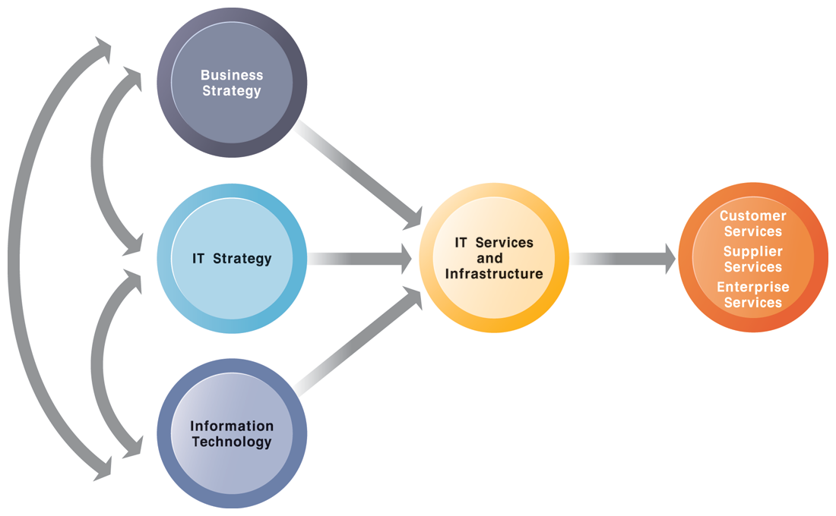
CHAPTER 5: IT INFRASTRUCTURE AND EMERGING TECHNOLOGIES
IT Infrastructure
CONNECTION BETWEEN THE FIRM, IT INFRASTRUCTURE, AND BUSINESS CAPABILITIES
FIGURE 5-1
The services a firm is capable of providing to its customers, suppliers, and employees are a direct function of its IT infrastructure. Ideally, this infrastructure should support the firm’s business and information systems strategy. New information technologies have a powerful impact on business and IT strategies, as well as the services that can be provided to customers.
© Prentice Hall 2011
Notes:
The point of this slide is to illustrate the centrality of IT infrastructure and services to the achievement of firm success. Ultimately, what the firm delivers to customers, its quality, is a direct function of the power of its infrastructure. For instance, Amazon is routinely sited as the most popular online shopping site and receives high praise from customers for the quality of its service and speed of execution. There is a reason for this: Amazon has one of the world’s largest computing infrastructures numbering several hundred thousand processors to provide these services.

Slide 4
CHAPTER 5: IT INFRASTRUCTURE AND EMERGING TECHNOLOGIES
IT Infrastructure
Evolution of IT infrastructure
  General-purpose mainframe & minicomputer era: 1959 to present
    1958 IBM first mainframes introduced
    1965 Less expensive DEC minicomputers introduced
  Personal computer era: 1981 to present
    1981 Introduction of IBM PC
    Proliferation in 80s, 90s resulted in growth of personal software
  Client/server era: 1983 to present
    Desktop clients networked to servers, with processing work split between clients and servers
    Network may be two-tiered or multitiered (N-tiered)
    Various types of servers (network, application, Web)
© Prentice Hall 2011
Notes:
Students may be unfamiliar with the concept of mainframe computers. Explain the difference in size (much larger) and computing capacity (much smaller) from today’s computers to give them a sense of perspective regarding how far the computing industry has gone in 60 years. However, modern-day mainframes (IBM z-Series), are extremely powerful servers used for large Fortune 1000 enterprise networks and corporate Web sites. The mainframe is not dead in other words and still represents a large revenue stream for IBM.

Slide 5
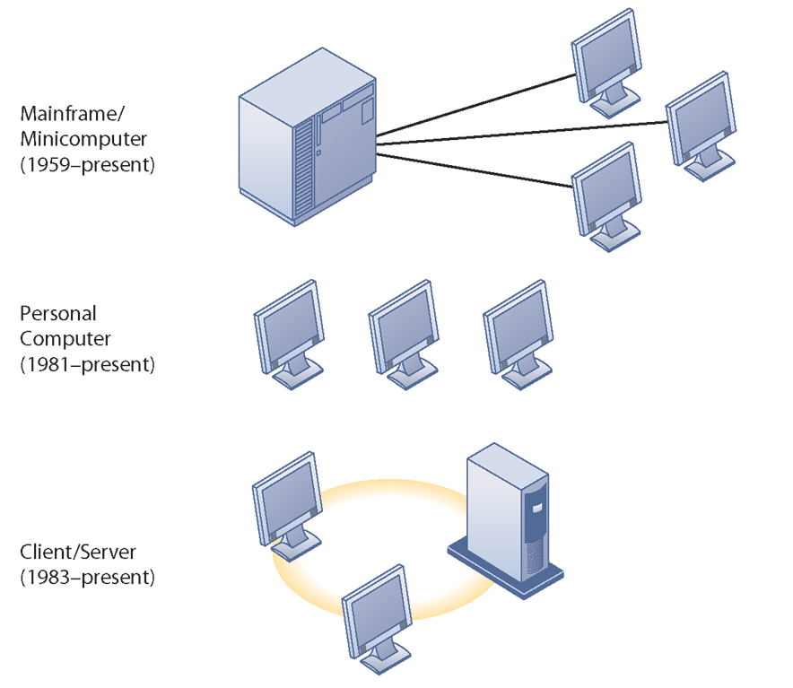
CHAPTER 5: IT INFRASTRUCTURE AND EMERGING TECHNOLOGIES
IT Infrastructure
STAGES IN IT INFRASTRUCTURE EVOLUTION
Illustrated here are the typical computing configurations characterizing each of the five eras of IT infrastructure evolution.
FIGURE 5-2
© Prentice Hall 2011
Notes:
This slide shows the portion of Figure 5-2 that illustrates the first three eras of IT infrastructure evolution discussed in the previous slide. Explain to students so they understand that the yellow ring connecting the machines in the client-server graphic represents a local area network. Personal computers were stand-alone systems prior to the development of local area networks.

Slide 6
CHAPTER 5: IT INFRASTRUCTURE AND EMERGING TECHNOLOGIES
IT Infrastructure
Evolution of IT infrastructure (cont.)
  Enterprise computing era: 1992 to present
    Move toward integrating disparate networks, applications using Internet standards and enterprise applications
  Cloud Computing: 2000 to present
    Refers to a model of computing where firms and individuals obtain computing power and software applications over the Internet or other network
    Fastest growing form of computing
© Prentice Hall 2011
Notes:
Examples of the use of cloud computing are Google Apps, Google’s suite of software applications that rivals Microsoft’s Office applications at a fraction of the cost, and Salesforce.com’s CRM management software, delivered over the Internet. Most large Fortune 500 firms have some applications that run in the cloud. Most of these same corporations do not put their strategic or critical systems on the cloud just yet because of lingering concerns about reliability and security.

Slide 7
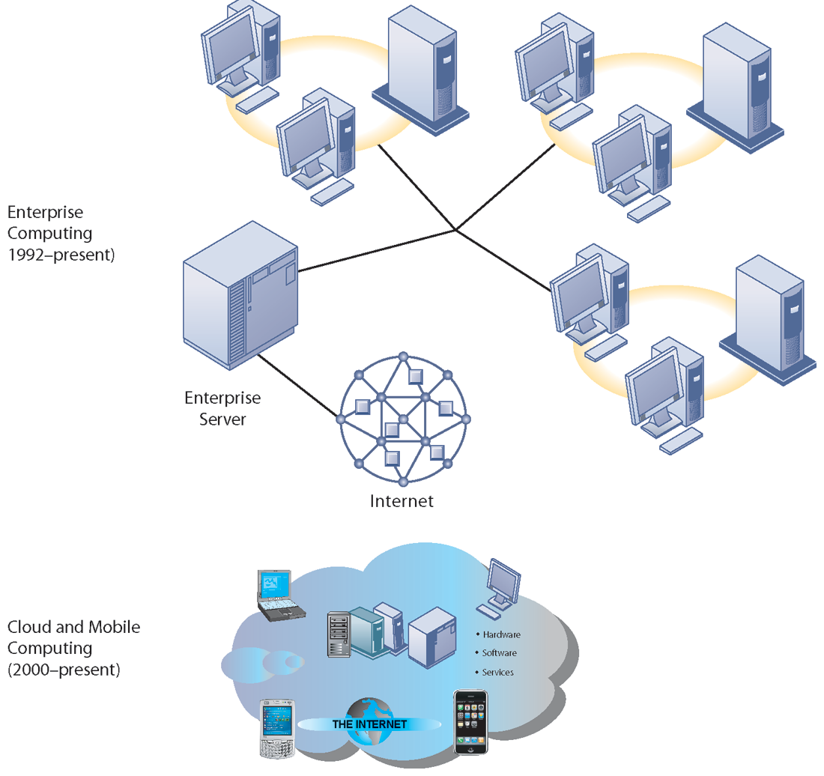
CHAPTER 5: IT INFRASTRUCTURE AND EMERGING TECHNOLOGIES
IT Infrastructure
STAGES IN IT INFRASTRUCTURE EVOLUTION (cont.)
Illustrated here are the typical computing configurations characterizing each of the five eras of IT infrastructure evolution.
FIGURE 5-2
© Prentice Hall 2011
Notes:
This slide shows the portion of Figure 5-2 that illustrates the last two eras of IT infrastructure evolution discussed in the previous slide. The enterprise Internet graphic represents several individual networks linked together into an enterprise-wide network. The cloud computing graph represents several types of technology that are capable of connecting to the Internet and accessing applications and services through a cloud. There is a Learning Track on the stages of IT infrastructure evolution.

Slide 8
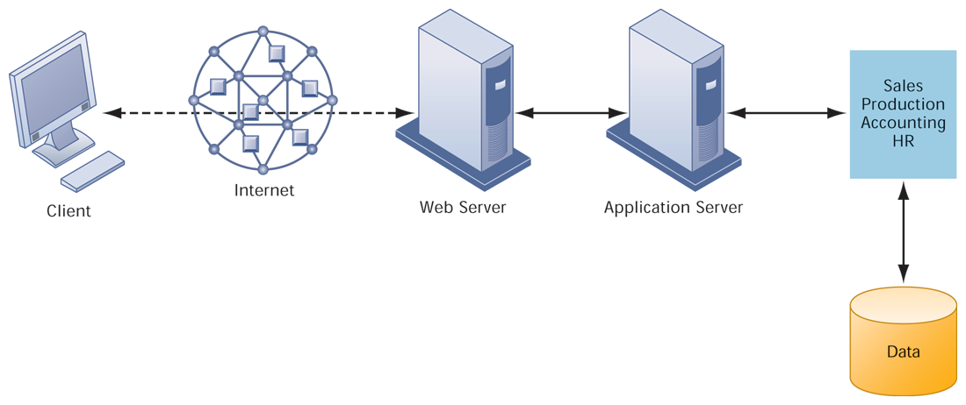
CHAPTER 5: IT INFRASTRUCTURE AND EMERGING TECHNOLOGIES
IT Infrastructure
A MULTITIERED CLIENT/SERVER NETWORK (N-TIER)
FIGURE 5-3
In a multitiered client/server network, client requests for service are handled by different levels of servers.
© Prentice Hall 2011
Notes:
Explain that the distribution of computing power across smaller, less expensive machines enabled by client/server computing is in part responsible for the drastic increase in computing power and applications throughout the firm. Prior to small, less expensive server computers, computing power had to be purchased in large blocks at great expense. With client/server computing, you can grow your firm’s inventory of computers gradually, over time, to meet current demand.

Slide 9
CHAPTER 5: IT INFRASTRUCTURE AND EMERGING TECHNOLOGIES
IT Infrastructure
Technology drivers of infrastructure evolution
  Moore’s law and microprocessing power
    Computing power doubles every 18 months
    Nanotechnology:
      Shrinks size of transistors to size comparable to size of a virus
  Law of Mass Digital Storage
    The amount of data being stored each year doubles
© Prentice Hall 2011
Notes:
Variants of Moore’s Law include: the number of transistors on a chip doubles every 18 months; computing power doubles every 18 months; and the price of computing falls by half every 18 months. Explain to students that even now, this trend is likely to continue, with transistors reaching the sizes of viruses, the smallest form of life.

Slide 10
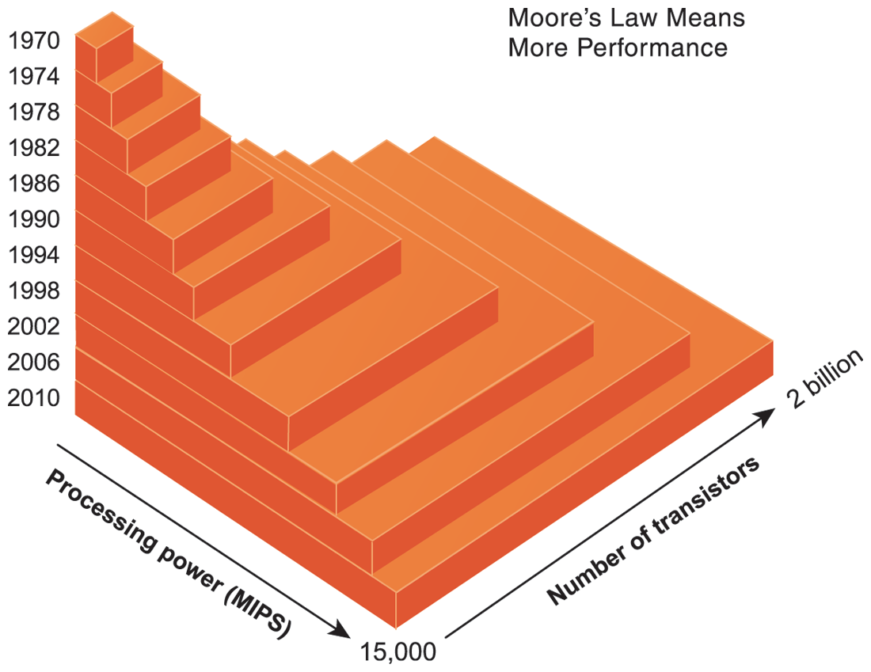
CHAPTER 5: IT INFRASTRUCTURE AND EMERGING TECHNOLOGIES
IT Infrastructure
MOORE’S LAW AND MICROPROCESSOR PERFORMANCE
Packing over 2 billion transistors into a tiny microprocessor has exponentially increased processing power. Processing power has increased to over 500,000 MIPS (millions of instructions per second).
FIGURE 5-4
© Prentice Hall 2011
Notes:
At what point, if any, do students believe that the doubling trend of Moore’s Law might come to an end? Ask them to speculate and give reasons for their answers.

Slide 11
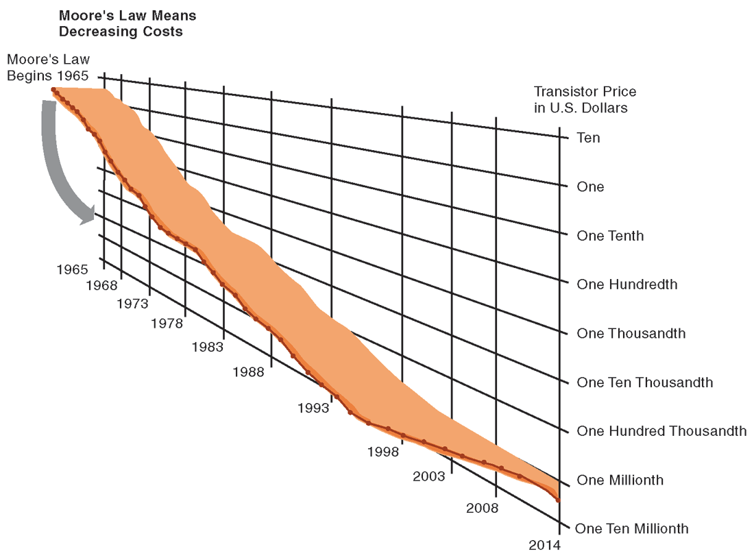
CHAPTER 5: IT INFRASTRUCTURE AND EMERGING TECHNOLOGIES
IT Infrastructure
FALLING COST OF CHIPS
Packing more transistors into less space has driven down transistor cost dramatically as well as the cost of the products in which they are used.
FIGURE 5-5
© Prentice Hall 2011
Notes:
What do students think the implications of such drastically reduced costs of computer chips might be in the future? Explain the connection to concepts like the digital divide and cloud computing.

Slide 12
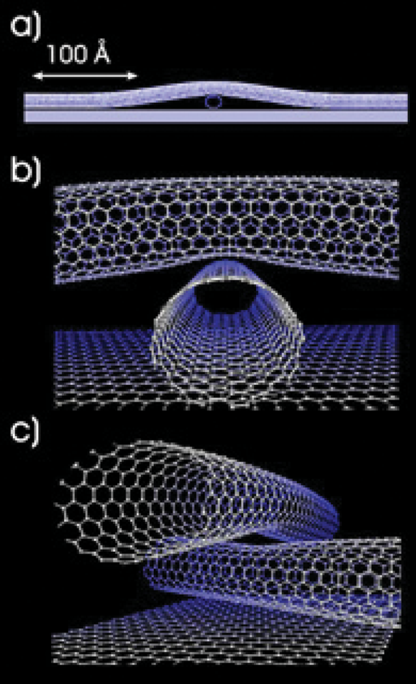
CHAPTER 5: IT INFRASTRUCTURE AND EMERGING TECHNOLOGIES
IT Infrastructure
EXAMPLES OF NANOTUBES
Nanotubes are tiny tubes about 10,000 times thinner than a human hair. They consist of rolled up sheets of carbon hexagons and have potential uses as minuscule wires or in ultrasmall electronic devices and are very powerful conductors of electrical current.
FIGURE 5-6
© Prentice Hall 2011
Notes:
Nanotechnology is used to create transistors of the tiny size previously mentioned. Can students describe any other applications of this type of technology (for example, medical)?

Slide 13
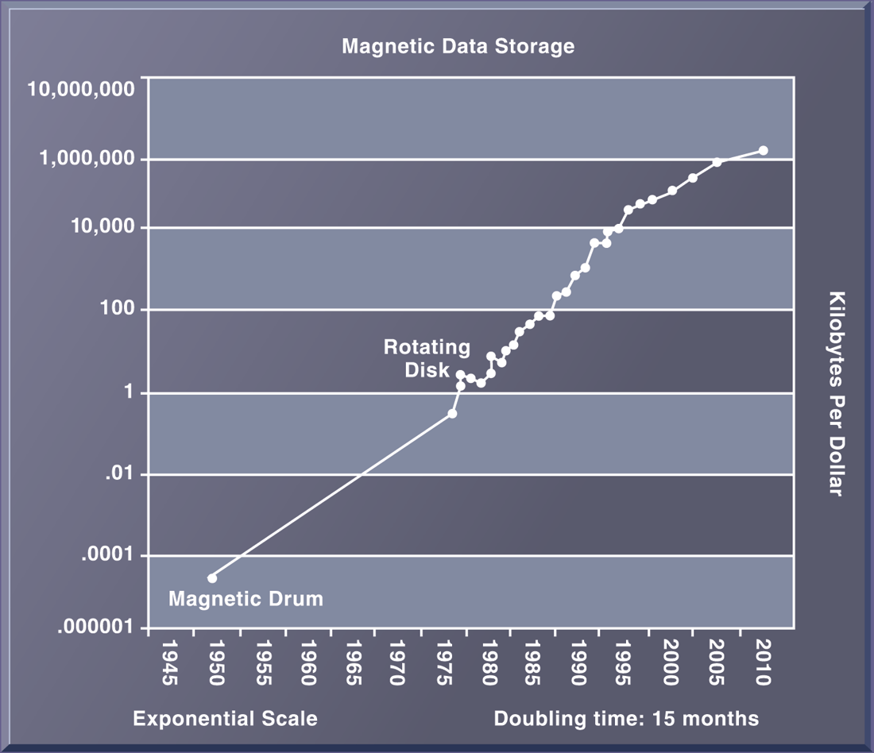
CHAPTER 5: IT INFRASTRUCTURE AND EMERGING TECHNOLOGIES
IT Infrastructure
THE COST OF STORING DATA DECLINES EXPONENTIALLY 1950–2010
Since the first magnetic storage device was used in 1955, the cost of storing a kilobyte of data has fallen exponentially, doubling the amount of digital storage for each dollar expended every 15 months, on average.
FIGURE 5-7
© Prentice Hall 2011
Notes:
Explain the importance of the exponential growth in hard drive capacity, which is that the world is producing an increasing amount of digital information requiring storage each year as well. Fortunately, the cost of storing that information is decreasing at an even quicker rate. Explain that this figure displays the number of kilobytes of data that can be stored with one dollar. Point out that the Y axis is greatly compressed to display the doubling effect, and that if it weren’t, the increase from year to year would become increasingly enormous.

Slide 14
CHAPTER 5: IT INFRASTRUCTURE AND EMERGING TECHNOLOGIES
IT Infrastructure
Technology drivers of infrastructure evolution (cont.)
  Metcalfe’s Law and network economics
    Value or power of a network grows exponentially as a function of the number of network members
    As network members increase, more people want to use it (demand for network access increases)
© Prentice Hall 2011
Notes:
Ask students to explain the implications of Metcalfe’s Law to social networks, such as Facebook and MySpace. Do they agree that the more members are using the site, the value of being a member and the usefulness of the site grows? Do people make “new friends” on a social site or hang out with their existing friends mostly?

Slide 15
CHAPTER 5: IT INFRASTRUCTURE AND EMERGING TECHNOLOGIES
IT Infrastructure
Technology drivers of infrastructure evolution (cont.)
  Declining communication costs and the Internet
    An estimated 1.5 billion people worldwide have Internet access
    As communication costs fall toward a very small number and approach 0, utilization of communication and computing facilities explodes
© Prentice Hall 2011
Notes:
Are students aware of any friends or family that do not have Internet access? You might ask them to remember “life before the Internet”, if possible, to underscore the magnitude of how far communication and computing has come over time.

Slide 16
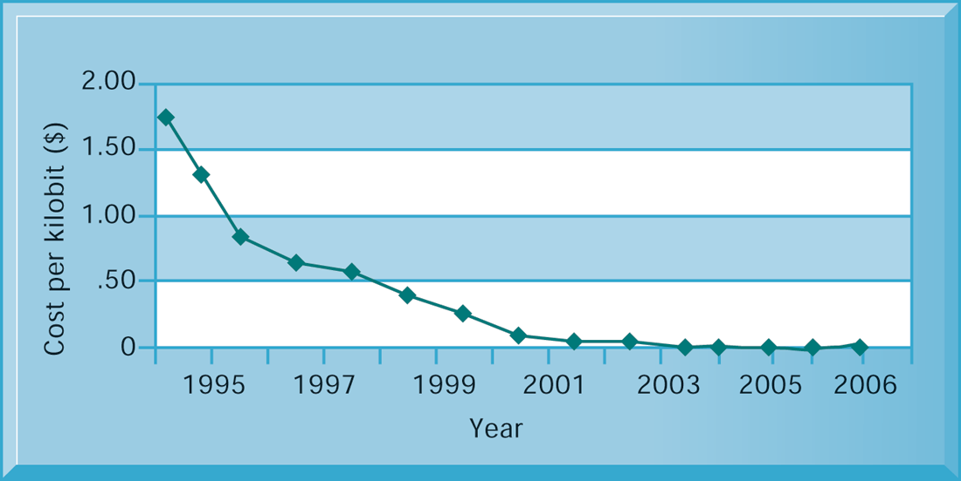
CHAPTER 5: IT INFRASTRUCTURE AND EMERGING TECHNOLOGIES
IT Infrastructure
EXPONENTIAL DECLINES IN INTERNET COMMUNICATIONS COSTS
FIGURE 5-8
One reason for the growth in the Internet population is the rapid decline in Internet connection and overall communication costs. The cost per kilobit of Internet access has fallen exponentially since 1995. Digital subscriber line (DSL) and cable modems now deliver a kilobit of communication for a retail price of around 2 cents.
© Prentice Hall 2011
Notes:
Emphasize to students how close the communication cost per kilobit has come to an infinitesimal number (nearly 0) since 1995. What implications does this have for the number of people using the Internet? You could once again relate this to the digital divide and emphasize that even now a significant portion of the world lacks access to the Internet and other services, though it has more to do with reasons of insufficient infrastructure than Internet communication costs. One implication: it costs no more to move a gigabyte from New York to San Francisco than it does to move the same amount of information from the top of a building to the basement. This means that data no longer needs to be located “close by” the user.

Slide 17
CHAPTER 5: IT INFRASTRUCTURE AND EMERGING TECHNOLOGIES
IT Infrastructure
Technology drivers of infrastructure evolution (cont.)
  Standards and network effects
    Technology standards:
      Specifications that establish the compatibility of products and the ability to communicate in a network
      Unleash powerful economies of scale and result in price declines as manufacturers focus on the products built to a single standard
© Prentice Hall 2011
Notes:
What might today’s enterprise infrastructure and Internet have been like without widespread and universal standards, such as Windows, Microsoft Office, Unix, and Ethernet? (Greatly decreased efficiency and confusion, inability to develop innovative products everyone can use based on a single standard, etc.)

Slide 18
CHAPTER 5: IT INFRASTRUCTURE AND EMERGING TECHNOLOGIES
Infrastructure Components
IT Infrastructure has 7 main components
  Computer hardware platforms
  Operating system platforms
  Enterprise software applications
  Data management and storage
  Networking/telecommunications platforms
  Internet platforms
  Consulting system integration services
© Prentice Hall 2011
Notes:
The upcoming slides will go over each component in more detail.

Slide 19
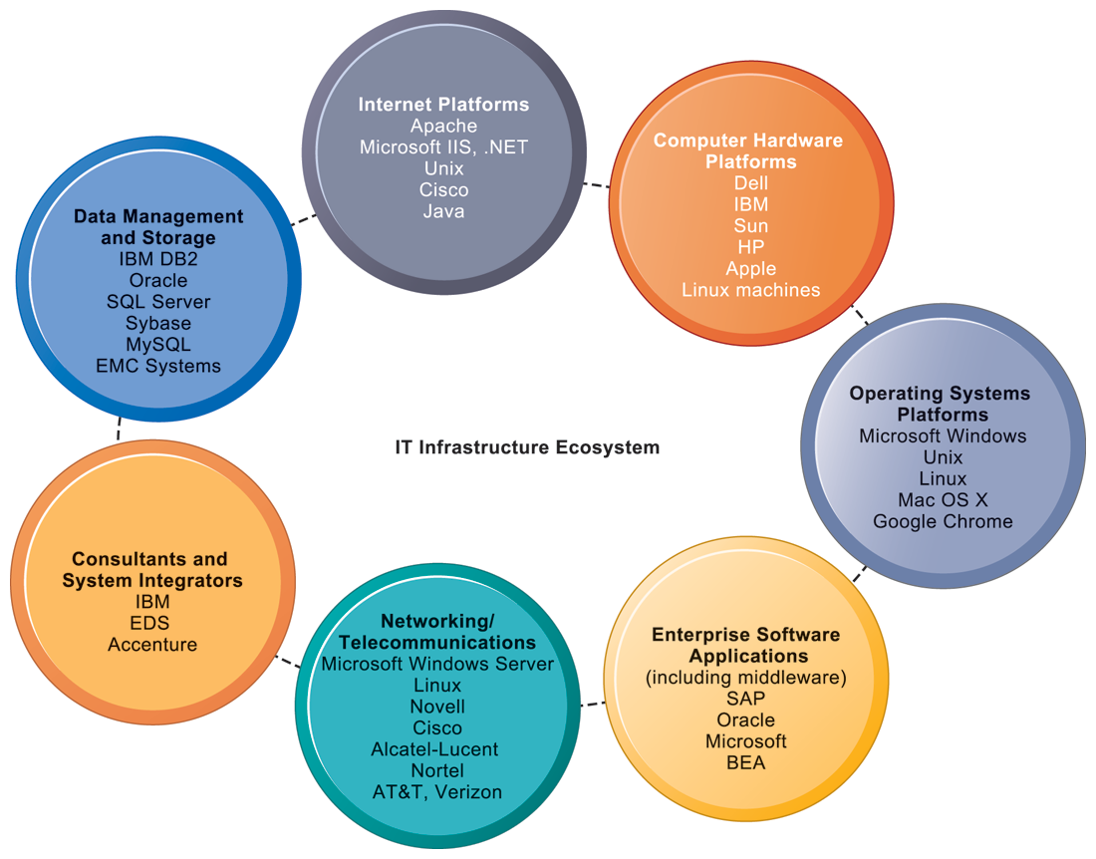
CHAPTER 5: IT INFRASTRUCTURE AND EMERGING TECHNOLOGIES
IT Infrastructure
THE IT INFRASTRUCTURE ECOSYSTEM
There are seven major components that must be coordinated to provide the firm with a coherent IT infrastructure. Listed here are major technologies and suppliers for each component.
FIGURE 5-9
© Prentice Hall 2011
Notes:
Ask students to take a look at the example companies that appear under each heading. What companies appear repeatedly? How many items are unfamiliar?

Slide 20
CHAPTER 5: IT INFRASTRUCTURE AND EMERGING TECHNOLOGIES
Infrastructure Components
Computer hardware platforms
  Client machines
    Desktop PCs, mobile devices – PDAs, laptops
  Servers
    Blade servers: ultrathin computers stored in racks
  Mainframes:
    IBM mainframe equivalent to thousands of blade servers
  Top chip producers: AMD, Intel, IBM
  Top firms: IBM, HP, Dell, Sun Microsystems
© Prentice Hall 2011
Notes:
To give students an idea of the size of the market for computer hardware, in 2010, U.S. firms spent $109 billion on computer hardware; worldwide, over 400 million computers were sold.

Slide 21
CHAPTER 5: IT INFRASTRUCTURE AND EMERGING TECHNOLOGIES
Infrastructure Components
Operating system platforms
  Operating systems
    Server level: 75% run Windows; 25% run Unix or Linux
    Client level:
      90% run Microsoft Windows (XP, 2000, CE, etc.)
      Handheld device OS’s (Android, iPhone OS)
      Cloud computing OS’s (Google’s Chrome OS)
Enterprise software applications
  Enterprise application providers: SAP and Oracle
  Middleware providers: BEA
© Prentice Hall 2011
Notes:
Emphasize Microsoft’s traditional dominance in operating systems and explain that it is the most important reason for their success to date. The market for enterprise software applications is approximately $250 billion dollars. These applications are considered to be part of IT infrastructure. Traditionally, large firms were the most prominent users of enterprise software, but firms such as Microsoft are trying to move into the untapped market of small- and medium-sized businesses that might benefit from less expansive versions of the same software. Today, the proliferation of operating systems for handhelds, cloud computing, and multitouch surfaces may be mounting a challenge to Microsoft’s dominance.

Slide 22
CHAPTER 5: IT INFRASTRUCTURE AND EMERGING TECHNOLOGIES
Infrastructure Components
Data management and storage
  Database software:
    IBM (DB2), Oracle, Microsoft (SQL Server), Sybase (Adaptive Server Enterprise), MySQL
  Physical data storage:
    EMC Corp (large-scale systems), Seagate, Maxtor, Western Digital
  Storage area networks (SANs):
    Connect multiple storage devices on dedicated network
© Prentice Hall 2011
Notes:
Remind students that the amount of new information in the world is doubling every three years, driving the need for more efficient data management and storage.

Slide 23
CHAPTER 5: IT INFRASTRUCTURE AND EMERGING TECHNOLOGIES
Infrastructure Components
Networking/telecommunications platforms
  Telecommunication services
    Telecommunications, cable, telephone company charges for voice lines and Internet access
    AT&T, Verizon
  Network operating systems:
    Windows Server, Novell, Linux, Unix
  Network hardware providers:
    Cisco, Alcatel-Lucent, Nortel, Juniper Networks
© Prentice Hall 2011
Notes:
Firms spend $100 billion a year on networking and telecommunications hardware and a whopping $700 billion on networking services. Compare these in size to the previously mentioned figures in computer hardware platforms ($109 billion) and enterprise software applications ($250 billion). This comparison can highlight for the students the extent to which we are living in an era of telecommunications revolution as much as a computer era. The device in the hand is obvious to people, the communications network in the background is hidden.

Slide 24
CHAPTER 5: IT INFRASTRUCTURE AND EMERGING TECHNOLOGIES
Infrastructure Components
Internet platforms
  Hardware, software, management services to support company Web sites, (including Web hosting services) intranets, extranets
  Internet hardware server market: Dell, HP/Compaq, IBM
  Web development tools/suites: Microsoft (FrontPage, .NET) IBM (WebSphere) Sun (Java), independent software developers: Adobe, RealMedia
© Prentice Hall 2011
Notes:
Internet platforms are yet another area where Microsoft is featured prominently. Students at this point should be able to appreciate the sheer size of the company. The trend since the late 1990s has been to reduce the number of servers by increasing their size and power. Dell, HP/Compaq, and IBM have been the beneficiaries of this trend. Multi core processors, and blade servers, are two ways in which server power can be radically increased without increasing the foot print or the power requirements.

Slide 25
CHAPTER 5: IT INFRASTRUCTURE AND EMERGING TECHNOLOGIES
Infrastructure Components
Consulting and system integration services
  Even large firms do not have resources for a full range of support for new, complex infrastructure
  Software integration: ensuring new infrastructure works with legacy systems
  Legacy systems: older TPS created for mainframes that would be too costly to replace or redesign
  Accenture, IBM Global Services, EDS, Infosys, Wipro
© Prentice Hall 2011
Notes:
Implementing new infrastructure requires significant changes in business processes and procedures, training and education, and software integration. This is a task that firms struggle to achieve on their own, which drives the need for these services. The MIS course provides students with an excellent background to be a business systems consultant. Most business consulting today involves developing business processes and supporting systems. You might visit a job/career site in class to review the kinds of jobs available to students with IS or MIS majors. One recent report (2010) found that MIS majors were the most satisfied group of college graduates because their education led directly to a job! The survey, which was conducted by PayScale.com and reported in the Wall Street Journal October 12, 2010, found 54% of MIS majors were very satisfied with their majors. Psychology majors at 26%, were the least satisfied.

Slide 26
CHAPTER 5: IT INFRASTRUCTURE AND EMERGING TECHNOLOGIES
Contemporary Hardware Platform Trends
The emerging mobile digital platform
  Cell phones, smartphones (BlackBerry, iPhone)
    Have assumed data transmission, Web surfing, e-mail and IM duties
  Netbooks:
    Small, low-cost lightweight notebooks optimized for wireless communication and core computing tasks
  Tablets (iPad)
  Networked e-readers (Kindle)
© Prentice Hall 2011
Notes:
Business computing is increasingly moving from PCs and desktops to mobile devices, and managers are increasingly using these to coordinate work and communicate with employees. Students may think the iPhone they own is just a phone, or music player, but for businesses it is along with Blackberries an important management tool. Ask students for examples of how they are using smartphones in their business or work.

Slide 27
CHAPTER 5: IT INFRASTRUCTURE AND EMERGING TECHNOLOGIES
Contemporary Hardware Platform Trends
Grid computing
  Connects geographically remote computers into a single network to combine processing power and create virtual supercomputer
  Provides cost savings, speed, agility
Virtualization
  Allows single physical resource to act as multiple resources (i.e., run multiple instances of OS)
  Reduces hardware and power expenditures
  Facilitates hardware centralization
© Prentice Hall 2011
Notes:
Both grid computing and virtualization allow organizations to optimize their use of resources in new ways. Grid computing allows corporations to take advantage of spare computing power in the form of networked virtual supercomputers. Virtualization also allows companies to take advantage of spare computing power by allowing a single resource to act as multiple resources.

Slide 28
CHAPTER 5: IT INFRASTRUCTURE AND EMERGING TECHNOLOGIES
Contemporary Hardware Platform Trends
Cloud computing
  On-demand (utility) computing services obtained over network
    Infrastructure as a service
    Platform as a service
    Software as a service
  Cloud can be public or private
  Allows companies to minimize IT investments
  Drawbacks: Concerns of security, reliability
© Prentice Hall 2011
Notes:
Explain that on-demand or utility computing describes a payment structure in which use is dependent upon actual time or power used. Cloud computing refers to a platform – networked access to remote services. Cloud computing allows organizations to avoid the expenses of maintaining their own hardware and software, relying on the cloud instead. Ask students if they have used Google Apps or other forms of cloud computing. Are there any other concerns they might have over transferring computing resources to a shared “cloud”?

Slide 29
CHAPTER 5: IT INFRASTRUCTURE AND EMERGING TECHNOLOGIES
Contemporary Hardware Platform Trends
Green computing
  Practices and technologies for manufacturing, using, disposing of computing and networking hardware
Autonomic computing
  Industry-wide effort to develop systems that can configure, heal themselves when broken, and protect themselves from outside intruders
  Similar to self-updating antivirus software; Apple and Microsoft both use automatic updates
High performance, power-saving processors
  Multi-core processors
© Prentice Hall 2011
Notes:
Data centers will use more than 2 percent of all U.S. electrical power by 2011. Cutting power consumption in data centers has become both a serious business and environmental challenge. You can refer back to the chapter opening case on the Bay Area Rapid Transit system, which implemented a major upgrade and replacement of hardware and software to not only improve and update services but to also make tremendous savings in power expenditures. Ask students what forms of green computing they have noticed. Answers may range from more publicized local management of electronic equipment disposal and recycling to the use of solar chargers, etc. Another driver in minimizing the power consumption of computer processors is the proliferation of handheld devices; to reduce heat in the devices as well as lengthen time between battery charges.

Slide 30
CHAPTER 5: IT INFRASTRUCTURE AND EMERGING TECHNOLOGIES
Contemporary Software Platform Trends
Linux and open-source software
  Open-source software: Produced by community of programmers, free and modifiable by user
  Linux: Open-source software OS
Software for the Web
  Java:
    Object-oriented programming language
    Operating system, processor-independent
  Ajax
    Asynchronous JavaScript and XML
    Allows client and server to exchange small pieces of data without requiring the page to be reloaded
© Prentice Hall 2011
Notes:
Linux plays a major role in the administration of local area networks. Around 20 percent of the server operating system market is owned by Linux. Ask students to give reasons why an open-source operating system might be a better choice for network administrators than alternatives that are not open-source (such as Microsoft’s Windows server).
Java is designed to run on any computing device by use of the Java Virtual Machine. This includes mobile devices like smartphones.

Slide 31
CHAPTER 5: IT INFRASTRUCTURE AND EMERGING TECHNOLOGIES
Contemporary Software Platform Trends
Web Services
  Software components that exchange information using Web standards and languages
  XML: Extensible Markup Language
    More powerful and flexible than HTML
    Tagging allows computers to process data automatically
  SOAP: Simple Object Access Protocol
    Rules for structuring messages enabling applications to pass data and instructions
  WSDL: Web Services Description Language
    Framework for describing Web service and capabilities
  UDDI: Universal Description, Discovery, and Integration
    Directory for locating Web services
© Prentice Hall 2011
Notes:
Firms are collections of thousands of computer programs and systems built over many years. In general, these systems cannot “talk” with one another, and sharing information among them is very expensive. One way to get to work together is to build software links among them. This is the Web services approach (see the next slide on service oriented architecture). You can compare it to the Web: any computer with a browser can access billions of Web pages and draw down the information, or download PDF files that work on all computers that have a version of Adobe Acrobat installed. In a business firm, you want a similar environment: any computer program can get data from any other computer program. Web services makes this possible.
Ensure that students are able to explain the difference between XML and HTML (in other words, the additional features XML has compared to HTML). These include classifying, presenting, communicating, and storing data, as opposed to HTML being able to merely present data. These features also allow computers to manipulate documents written in XML automatically. Does this remind students of autonomic computing?

Slide 32
CHAPTER 5: IT INFRASTRUCTURE AND EMERGING TECHNOLOGIES
Contemporary Software Platform Trends
SOA: Service-oriented architecture
  Set of self-contained services that communicate with each other to create a working software application
  Software developers reuse these services in other combinations to assemble other applications as needed
    Example: an “invoice service” to serve whole firm for calculating and sending printed invoices
  Dollar Rent A Car
    Uses Web services to link online booking system with Southwest Airlines’ Web site
© Prentice Hall 2011
Notes:
Emphasize that SOA is a method of developing infrastructure using web services with an eye towards creating applications that draw data from several underlying (usually older “legacy” programs). All programs are built or re-designed to provide certain information (services) to all other programs. With SOA, developers incorporate each individual service into an application that successfully meets the needs of the organization.

Slide 33
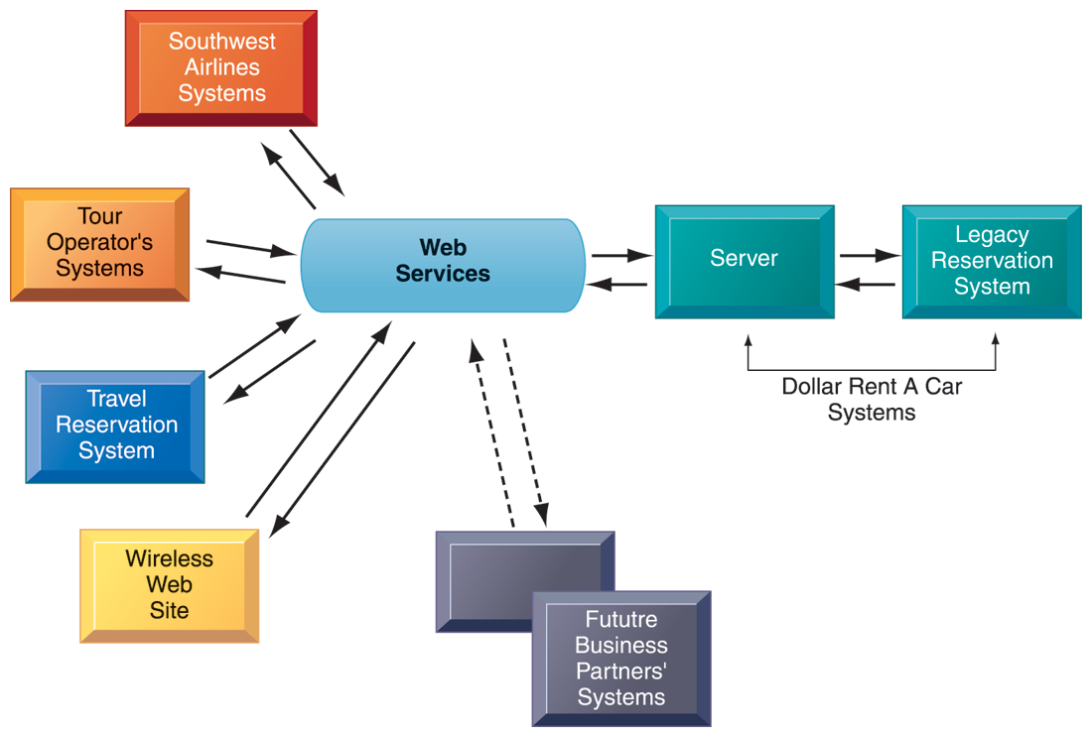
CHAPTER 5: IT INFRASTRUCTURE AND EMERGING TECHNOLOGIES
Contemporary Software Platform Trends
HOW DOLLAR RENT A CAR USES WEB SERVICES
FIGURE 5-10
Dollar Rent A Car uses Web services to provide a standard intermediate layer of software to “talk” to other companies’ information systems. Dollar Rent A Car can use this set of Web services to link to other companies’ information systems without having to build a separate link to each firm’s systems.
© Prentice Hall 2011
Notes:
Emphasize that the task Dollar wants to complete (interacting with other companies’ information systems) is represented here as a collection of individual services, in keeping with the SOA model. Dollar wants to be able to quickly and easily share data with other companies – the series of services provided above are combined to accomplish that task.

Slide 34
CHAPTER 5: IT INFRASTRUCTURE AND EMERGING TECHNOLOGIES
Contemporary Software Platform Trends
Software outsourcing and cloud services
  Three external sources for software:
    Software packages and enterprise software
    Software outsourcing (domestic or offshore)
      Domestic:
        Primarily for middleware, integration services, software support
      Offshore:
        Primarily for lower level maintenance, data entry, call centers, although outsourcing for new-program development is increasing
© Prentice Hall 2011
Notes:
This slide and the next two discuss the trend in software outsourcing and in cloud software services. Remind students that internal sources for software refers to developing software fully in house. Most companies today purchase or lease software or outsource development. Why do students think that software outsourcing is growing quickly in popularity? Have them point to trends that might back up their claims. How about offshore outsourcing (mostly to India and other English-speaking, developing countries)? Is it the lower wages paid to software engineers, or are the countries attractive to firms because they represent huge new markets to sell their goods and services?

Slide 35
CHAPTER 5: IT INFRASTRUCTURE AND EMERGING TECHNOLOGIES
Contemporary Software Platform Trends
Three external sources for software (cont.)
  Cloud-based software services
    Software as a service (SaaS)
    Accessed with Web browser over Internet
    Ranges from free or low-cost services for individuals to business and enterprise software
    Users pay on subscription or per-transaction
    E.g. Salesforce.com
    Service Level Agreements (SLAs): formal agreement with service providers
© Prentice Hall 2011
Notes:
Ask students what types of software they have used online. Have they worked for any companies using SaaS, and if so, what was the software’s function? Note that service level agreements are formal contracts between customers and their service providers that define the specific responsibilities of the service provider and the service expected by the customer. These are important to establish communication between the two firms and to manage the project efficiently.

Slide 36
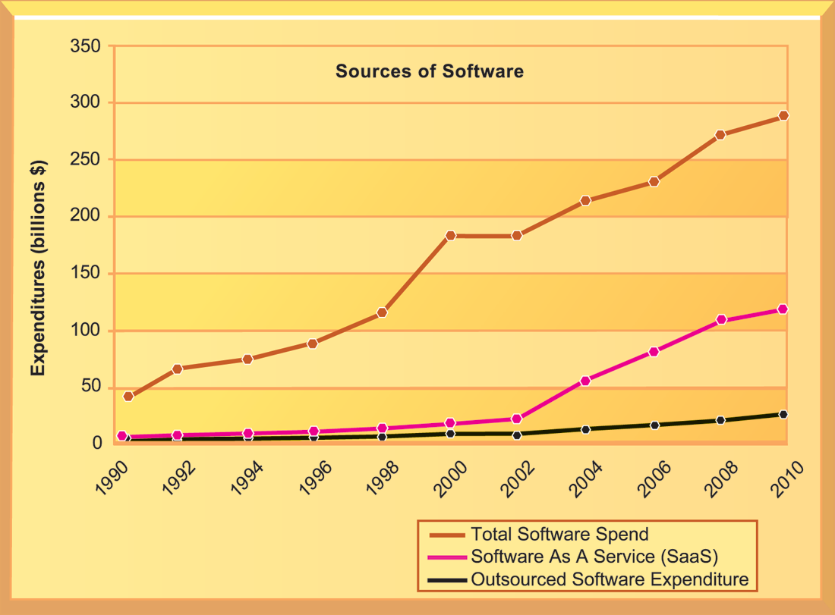
CHAPTER 5: IT INFRASTRUCTURE AND EMERGING TECHNOLOGIES
Contemporary Software Platform Trends
CHANGING SOURCES OF FIRM SOFTWARE
In 2010, U.S. firms will spend over $265 billion on software. About 40 percent of that ($106 billion) will originate outside the firm, either from enterprise software vendors selling firmwide applications or
individual application service providers leasing or selling software modules. Another 10 percent ($10 billion) will be provided by SaaS vendors as an online cloud-based service.
FIGURE 5-11
© Prentice Hall 2011
Notes:
Note the recent jump in SaaS spending within the last several years, and the pronounced rise in the last two or three years. What are the positives and negatives of acquiring software through the SaaS model? Positives: allows companies to focus on business issues rather than technology; for many companies, SaaS could cut costs. Negatives: SaaS increases the firm’s dependency on external suppliers. Wwhat happens if your supplier of SaaS services goes into bankruptcy? What is your backup plan?

Slide 37
CHAPTER 5: IT INFRASTRUCTURE AND EMERGING TECHNOLOGIES
Contemporary Software Platform Trends
Software outsourcing and cloud services (cont.)
  Mashups
    Combinations of two or more online applications, such as combining mapping software (Google Maps) with local content
  Apps
    Small pieces of software that run on the Internet, on your computer, or on your cell phone
      iPhone, BlackBerry, Android
    Generally delivered over the Internet
© Prentice Hall 2011
Notes:
In addition to the large enterprise software packages and services, some business tasks can be enabled through smaller programs or components that are combined to create a new function. The open-source movement, and the universal standards of Internet technologies, have created an environment in which software components can be created, used, and shared easily. Ask students which mashups and apps they have used. Have any students created any mashups or apps?

Slide 38
CHAPTER 5: IT INFRASTRUCTURE AND EMERGING TECHNOLOGIES
Management Issues
Dealing with platform and infrastructure change
  As firms shrink or grow, IT needs to be flexible and scalable
  Scalability:
    Ability to expand to serve larger numbers of users
  For mobile computing and cloud computing
    New policies and procedures for managing these new platforms
    Contractual agreements with firms running clouds and distributing software required
© Prentice Hall 2011
Notes:
How can IT be flexible and still make long-term investments in hardware and software? SaaS may solve some problems, but ask students to envision some of the pitfalls of working with an external hardware or software vendor such as Google or Salesforce.com. What are some nightmare scenarios that companies must guard against? For instance, the vendor fails to make critical applications available when needed, poor customer service, etc., or the vendor fails to upgrade equipment in order to save investment monies.

Slide 39
CHAPTER 5: IT INFRASTRUCTURE AND EMERGING TECHNOLOGIES
Management Issues
Management and governance
  Who controls IT infrastructure?
  How should IT department be organized?
    Centralized
      Central IT department makes decisions
    Decentralized
      Business unit IT departments make own decisions
  How are costs allocated between divisions, departments?
© Prentice Hall 2011
Notes:
What are the ramifications of poor IT governance at a firm? For example, if a company does not clearly define what departments have the responsibility to make their own IT decisions, what could the consequences be? Some potential consequences are data mismanagement, poor communication, and slower response times to crises.

Slide 40
CHAPTER 5: IT INFRASTRUCTURE AND EMERGING TECHNOLOGIES
Management Issues
Making wise infrastructure investments
  Amount to spend on IT is complex question
    Rent vs. buy, outsourcing
  Total cost of ownership (TCO) model
    Analyzes direct and indirect costs
    Hardware, software account for only about 20% of TCO
    Other costs: Installation, training, support, maintenance, infrastructure, downtime, space and energy
    TCO can be reduced through use of cloud services, greater centralization and standardization of hardware and software resources
© Prentice Hall 2011
Notes:
What types of companies should opt to rent as opposed to buy software? Possibly, companies with seasonal employees or semi-annual workloads. What differences between the two can students point to?
TCO is a way of quantifying some of the hidden costs of hardware. Ask students to make the connection between the TCO of handling software and hardware infrastructure internally as opposed to acquiring it from an outside vendor. Is this an additional incentive to outsource?

Slide 41
CHAPTER 5: IT INFRASTRUCTURE AND EMERGING TECHNOLOGIES
Management Issues
Competitive forces model for IT infrastructure investment
  Market demand for firm’s services
  Firm’s business strategy
  Firm’s IT strategy, infrastructure, and cost
  Information technology assessment
  Competitor firm services
  Competitor firm IT infrastructure investments
© Prentice Hall 2011
Notes:
How important of an impact do competitors’ services and investments affect a firm’s IT services and infrastructure? Is it wise to rely on those factors alone to determine what kind of services your firm provides? For instance, your competitors may not be the industry’s best example of how to develop IT services. In fact, your entire industry might be technological laggards. In this case, it might be better to look at best practices in other industries which have a reputation for superior IT services and capabilities.

Slide 42
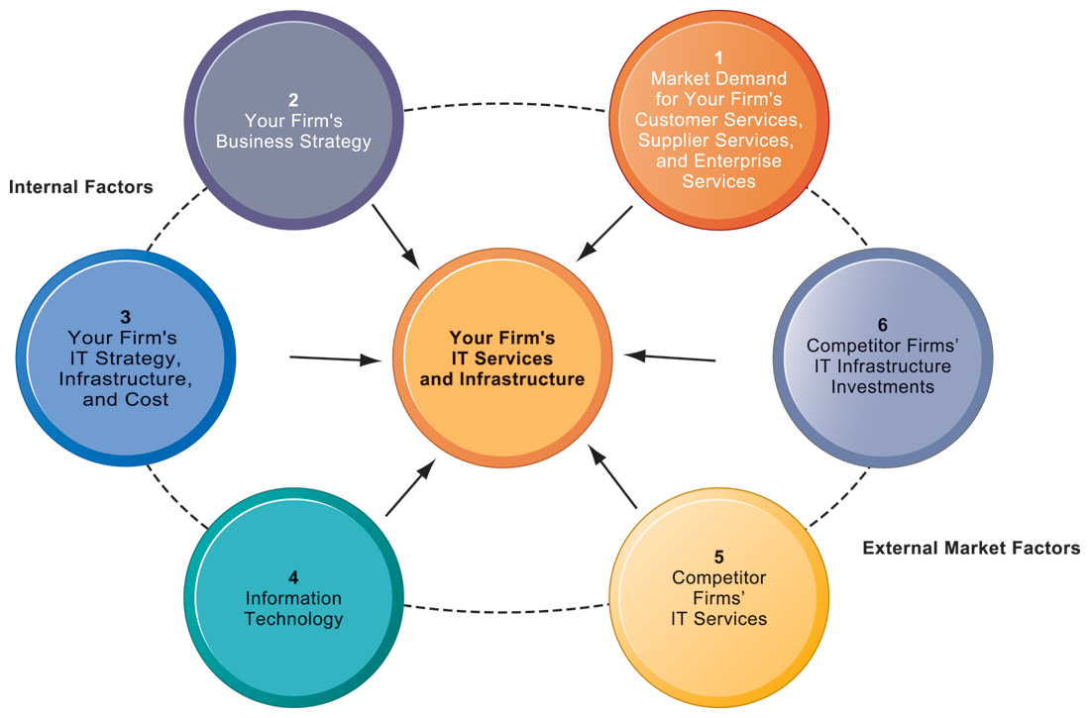
CHAPTER 5: IT INFRASTRUCTURE AND EMERGING TECHNOLOGIES
Management Issues
COMPETITIVE FORCES MODEL FOR IT INFRASTRUCTURE
FIGURE 5-12
There are six factors you can use to answer the question, “How much should our firm spend on IT infrastructure?”
© Prentice Hall 2011
Notes:
Ask students to explain how each item affects a firm’s IT services and infrastructure. Do they feel that any one of the six is especially important (or unimportant)? You can also use this diagram as a framework for understanding why some firms fail to develop a workable, powerful IT infrastructure.

